Slide 1
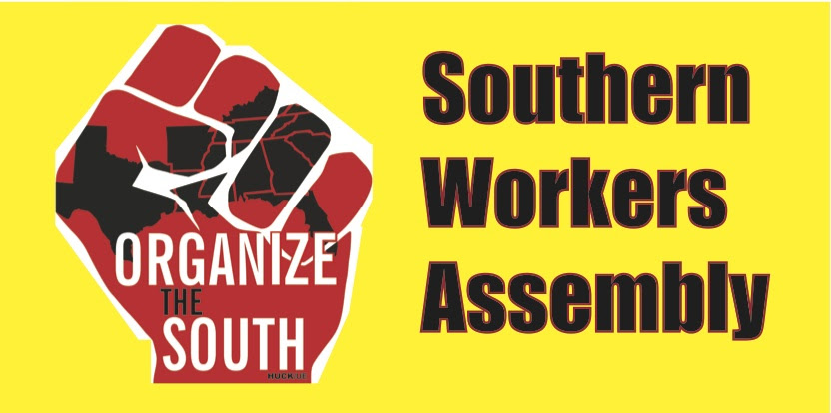
Why do we have to fight both the capitalist system and their state?
Southern Workers Assembly School
May 16, 2021

Slide 2
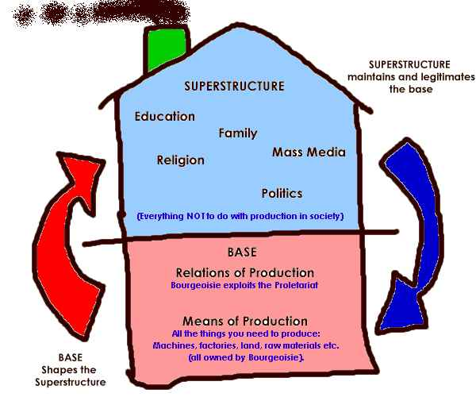
The big picture: the base and the superstructure
The entire society is built on the
economy, and that means based on our labor.
There are many ways to understand how our labor fits into the superstructure of the society. A key institution is the state (government) and politics.

Slide 3
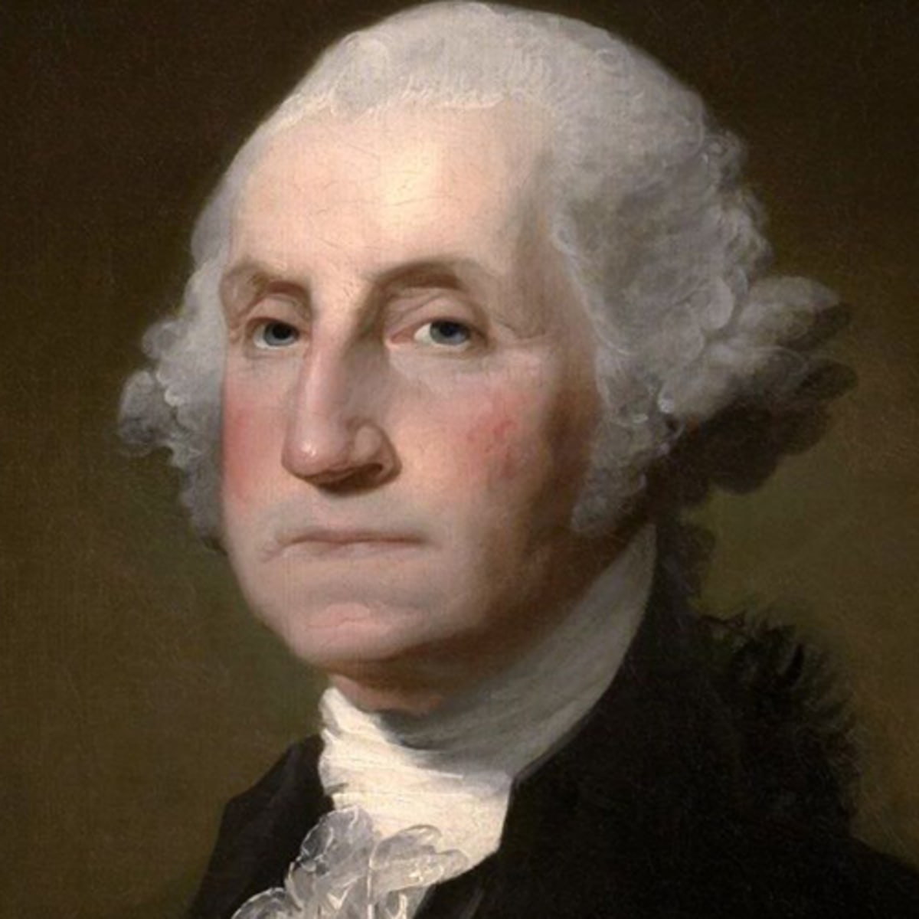
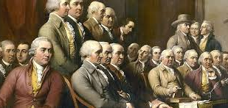
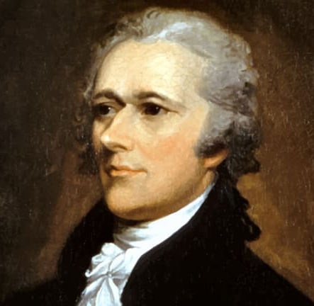
What class did the founders serve?
75% of the signers of the Declaration of Independence owned slaves.
Of the 55 delegates to the Constitutional Convention, about 25 owned slaves. Of the first 12 presidents, 8 owned slaves.
King?
Alexander Hamilton. In his words he wanted the Constitution “to give to the rich and well born a distinct and permanent share in the government. They will check the unsteadiness of the mass of the people.”
“The Constitution was ratified by a vote of probably not more than one-sixth of the adult males.”—historian Charles Beard

Slide 4
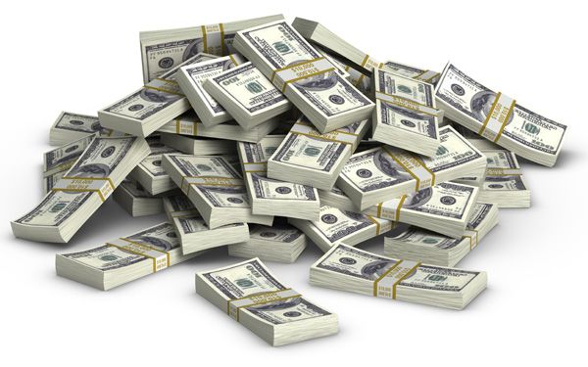
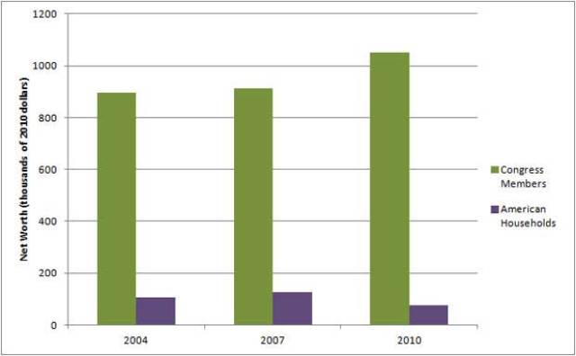
Almost half of the house of representatives and 67% of the senate are millionaires
How about us?
Green, Congress members net worth. Purple, U.S. households net worth.

Slide 5
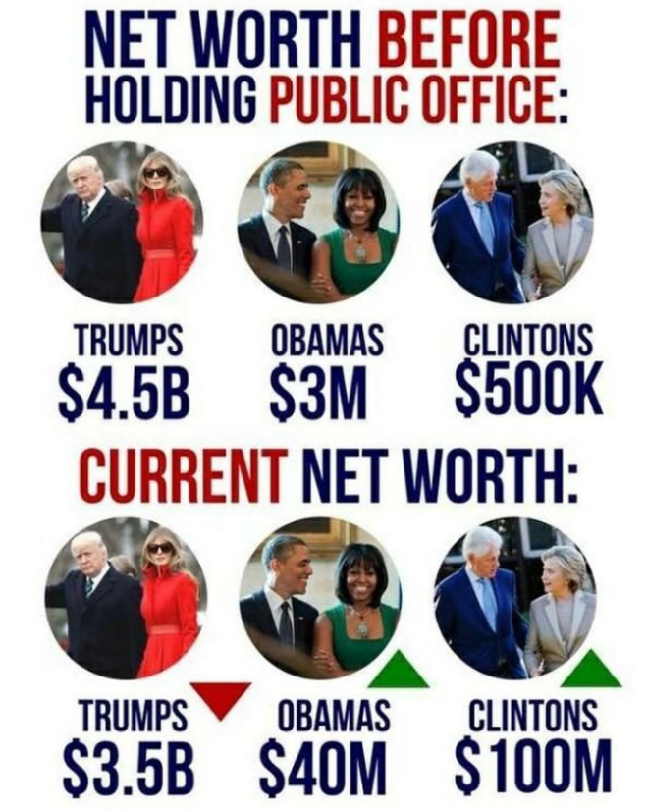
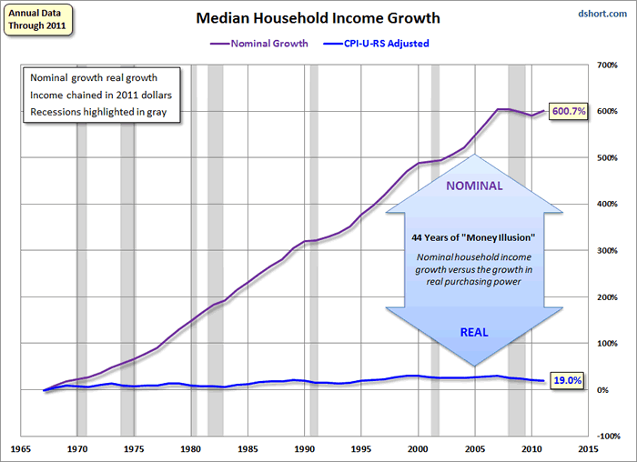
Capitalism is for the rich, not the rest of us, and they pay their political staff well
Our incomes have gone up only if you ignore inflation

Slide 6
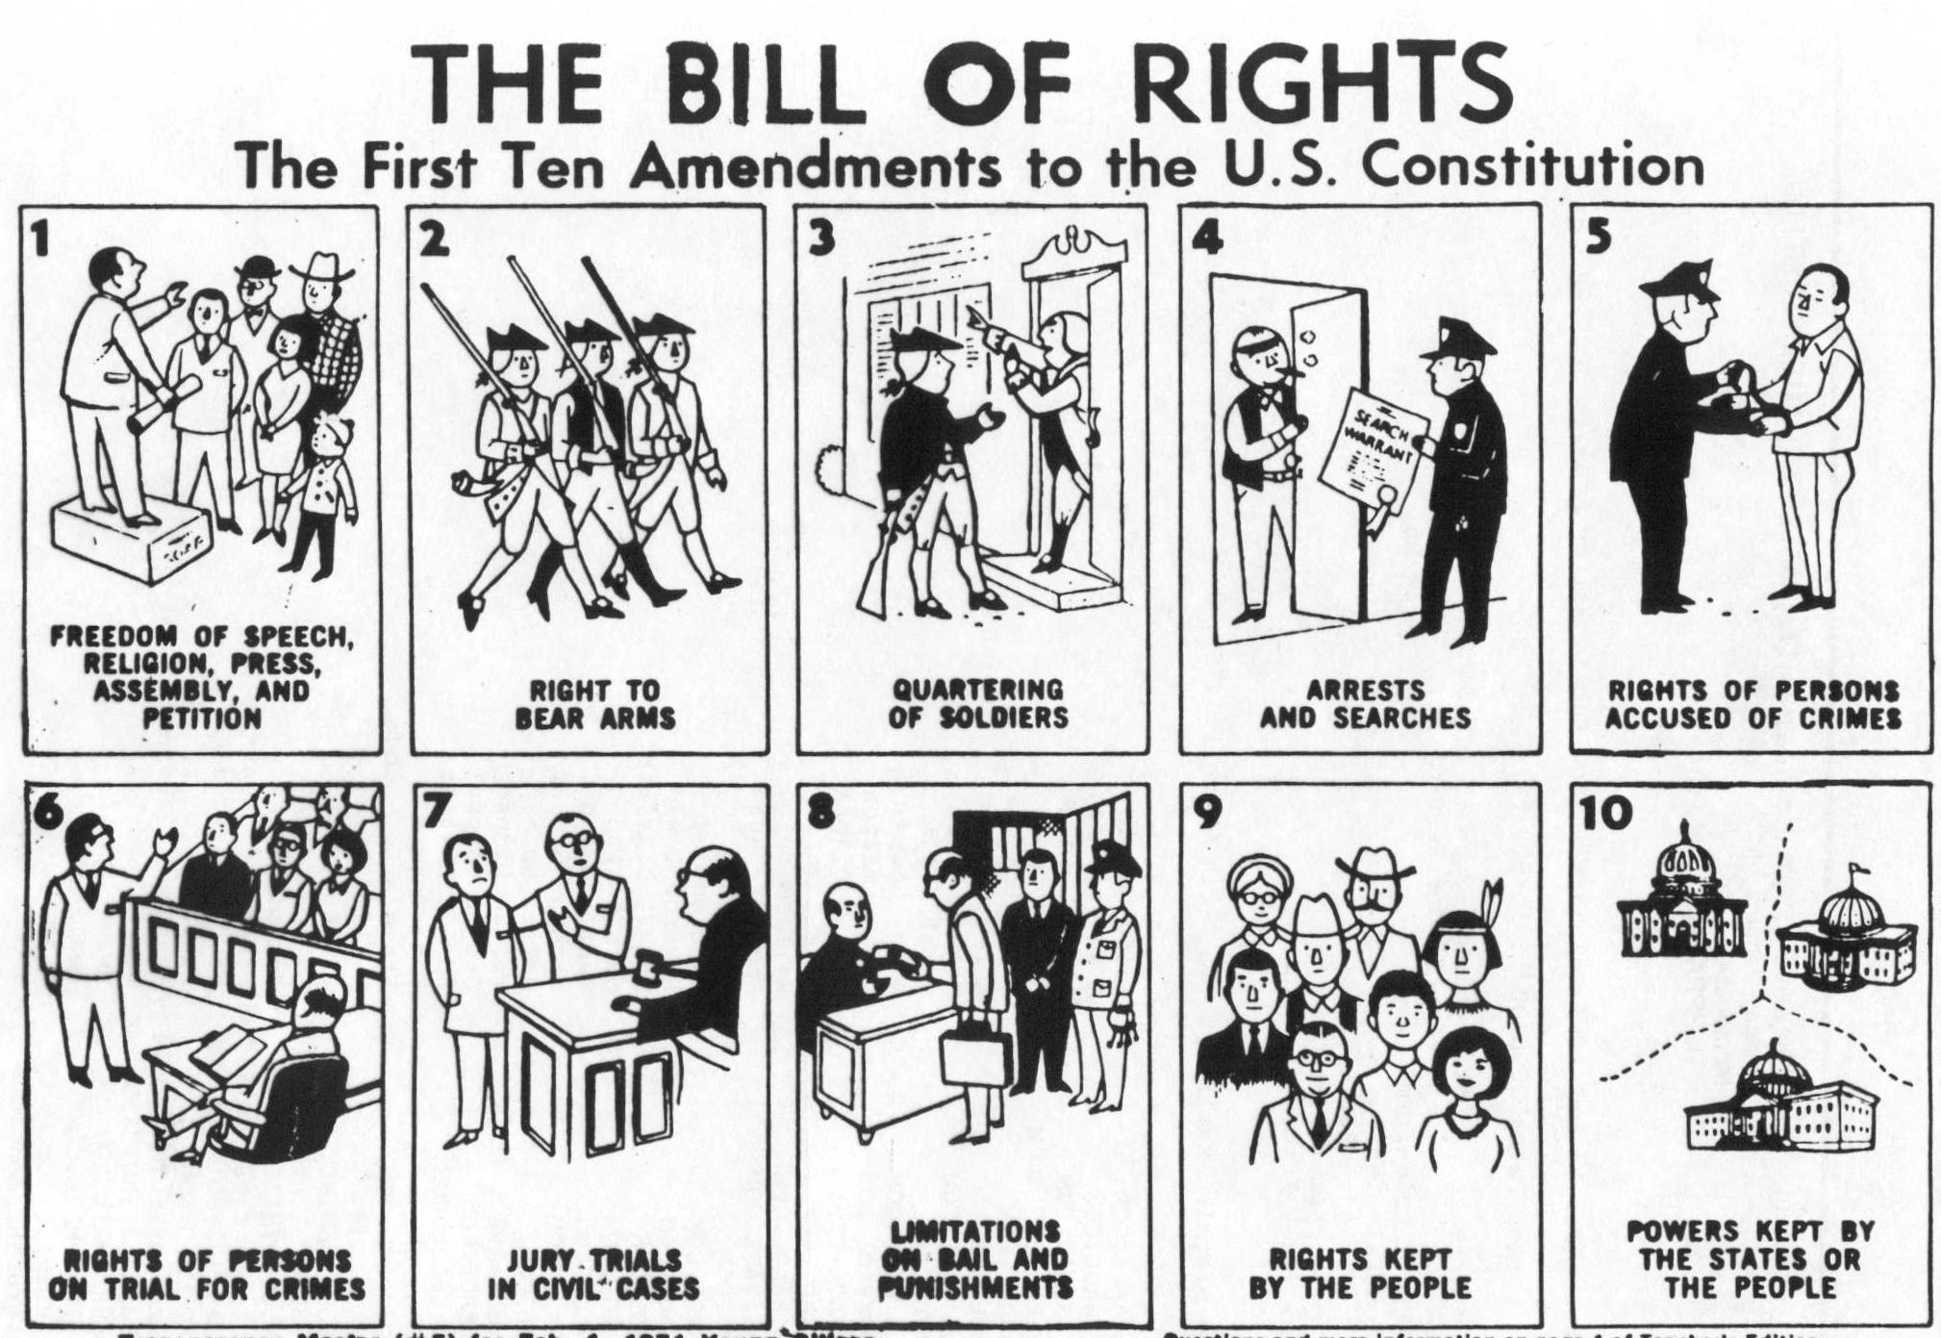

Slide 7
The Wagner Act of 1935
Also known as the National Labor Relations Act (NLRA). Guarantees workers right to organize. Outlines the legal framework for labor unions and management relations. Protects workers. Gives a framework for collective bargaining.
UNIONS ARE
KEY
TO WORKING
CLASS POWER

Slide 8
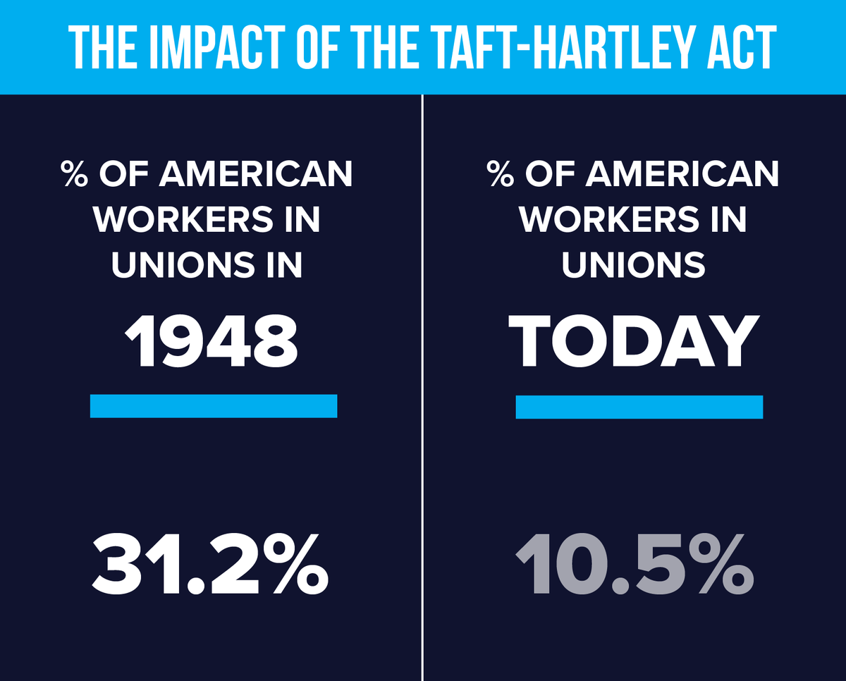
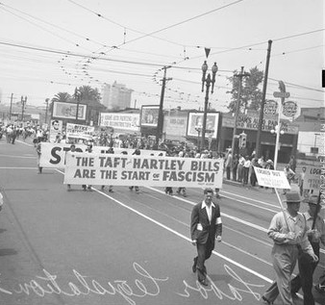
The Taft-Hartley Act of 1947
AKA the Labor Management Relations Act of 1947. A federal law that restricts the activities and power of labor unions. Enacted by the 80th United States Congress over the veto of President Harry S. Truman, becoming law on June 23, 1947
WHY?

Slide 9
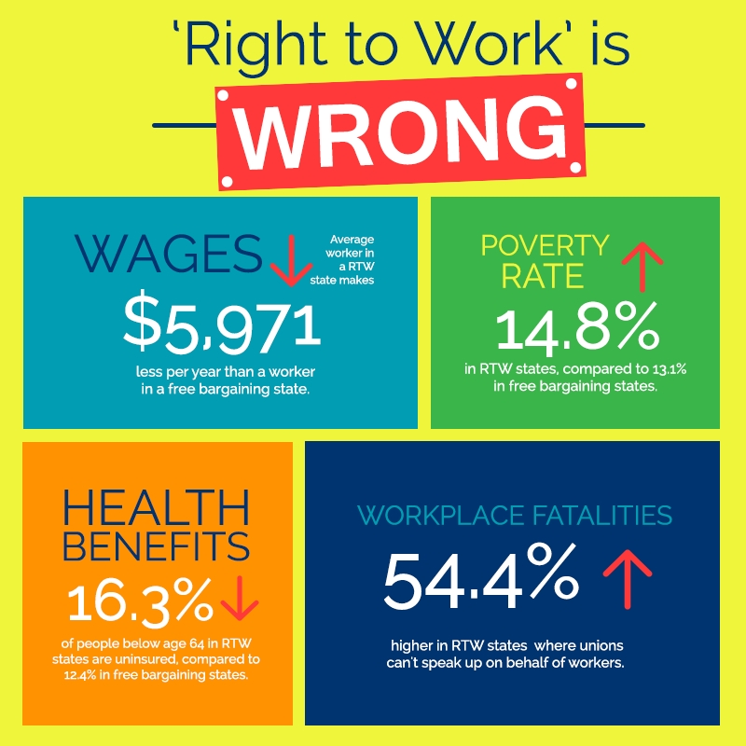
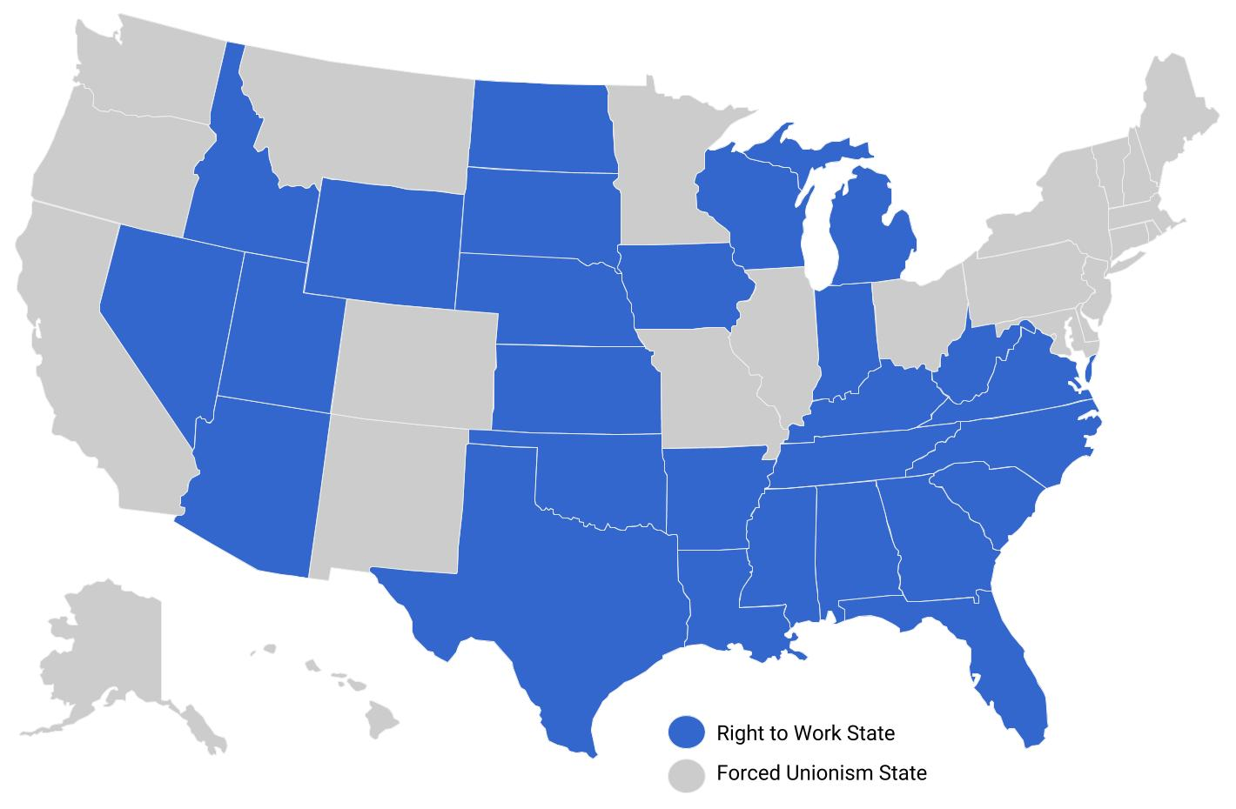
Anti-union “right-to-work” states
More than half of the 50 states have enacted so-called "right to work" laws. They dictate that no one can be compelled to join a union or pay dues as a condition of employment. They prohibit contracts that require hiring only unionized workers.
Anti-union so-called “right to work” states shown in gold
No unions only benefits the capitalists

Slide 10
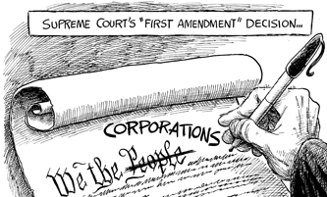
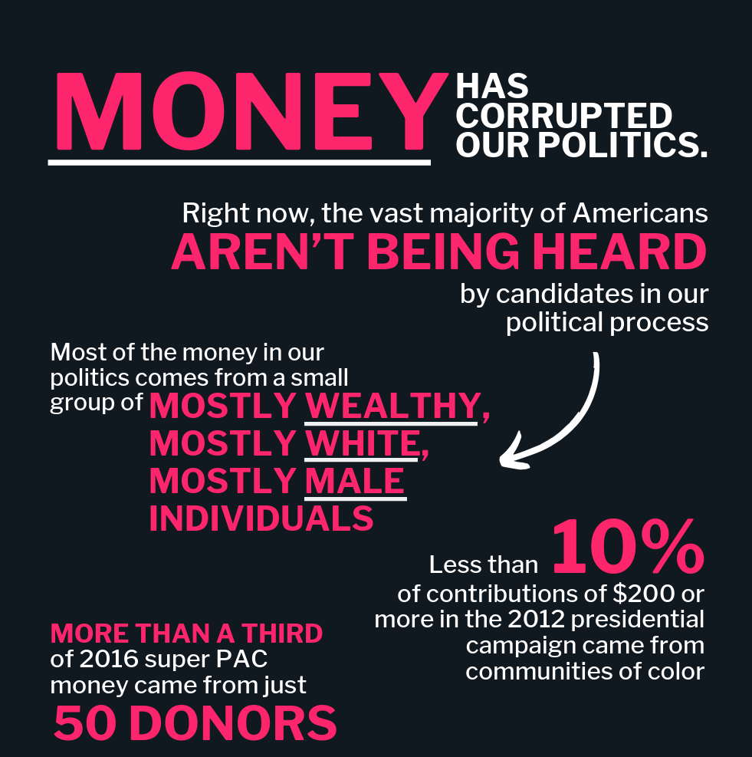
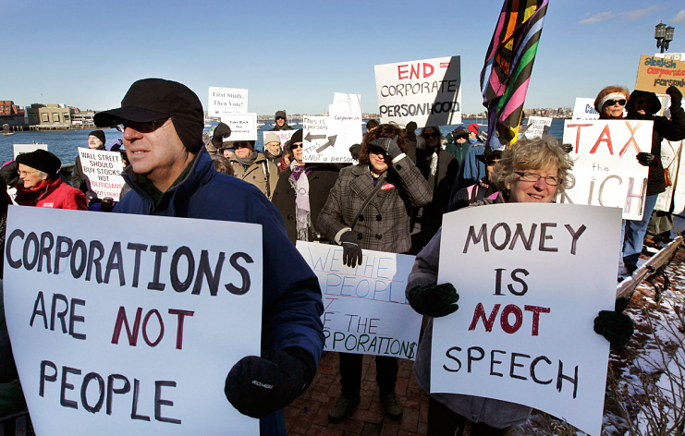
Citizens United v. Federal Election Commission
In 2010 the Supreme Court ruled 5-4 that the First Amendment (freedom of speech) prohibits limits on corporate funding of independent broadcasts in candidate elections. The justices said that the government's rationale for the limits on corporate spending—to prevent corruption—was not persuasive enough to restrict political speech.

Slide 11
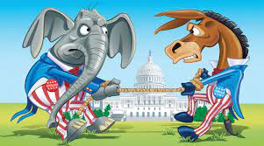
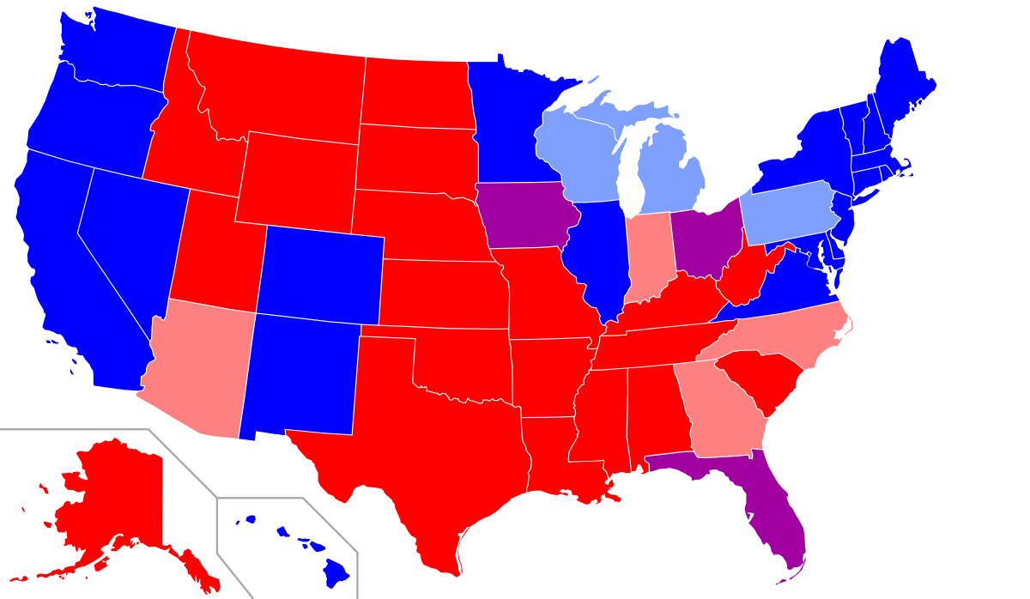
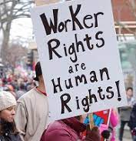
Red states controlled by Republicans
Blue states controlled by Democrats
Which side are we on?

Slide 12
Red states controlled by Republicans
Blue states controlled by Democrats
Gold states anti-union “RTW”
One third of the 74 million who voted for Trump in 2020 earned less than $50,000
Step one = the right to organize

Slide 13
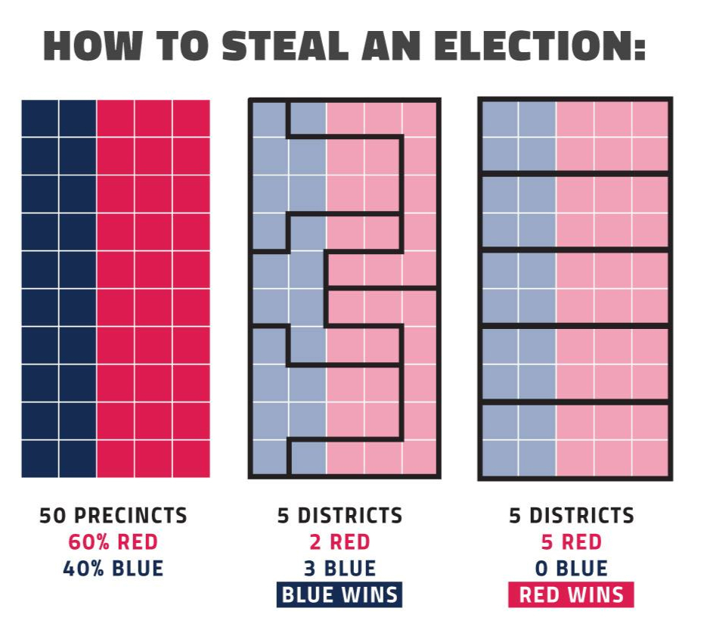
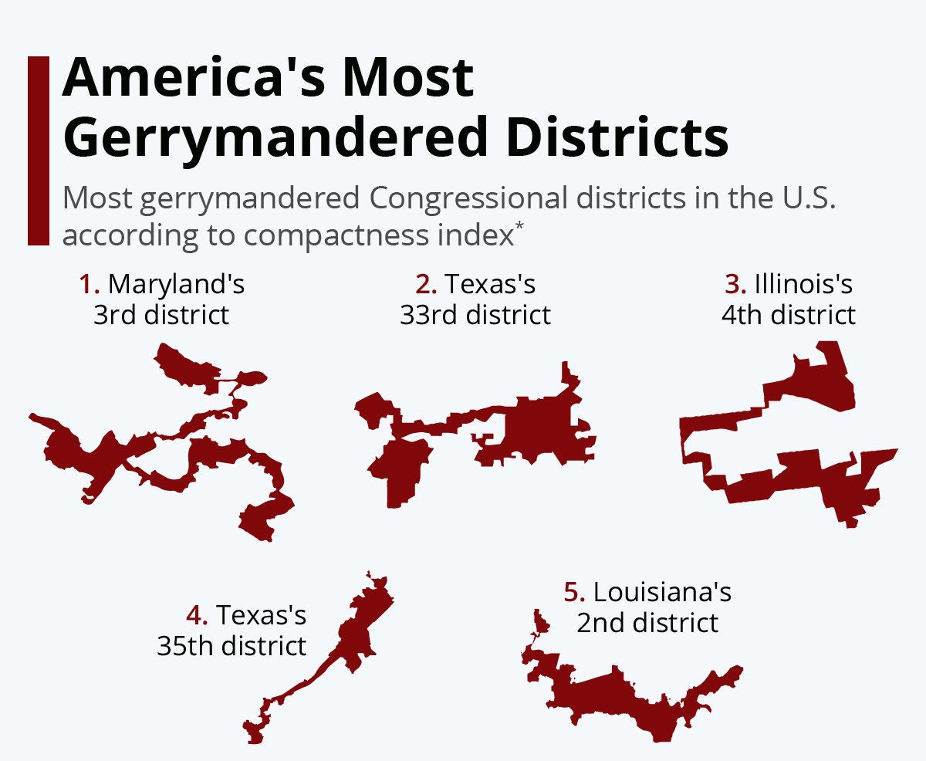
How they steal elections: Gerrymandering
Gerrymandering = drawing weird districts to ensure political power. What state legislatures do after each census of the population. Dominated by rural Republicans who implement minority rule.

Slide 14
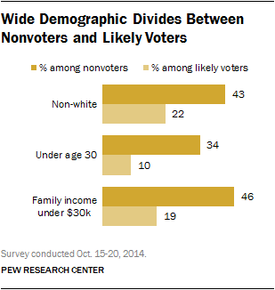
They win when we don’t vote
In politics we can fight as a class

Slide 15
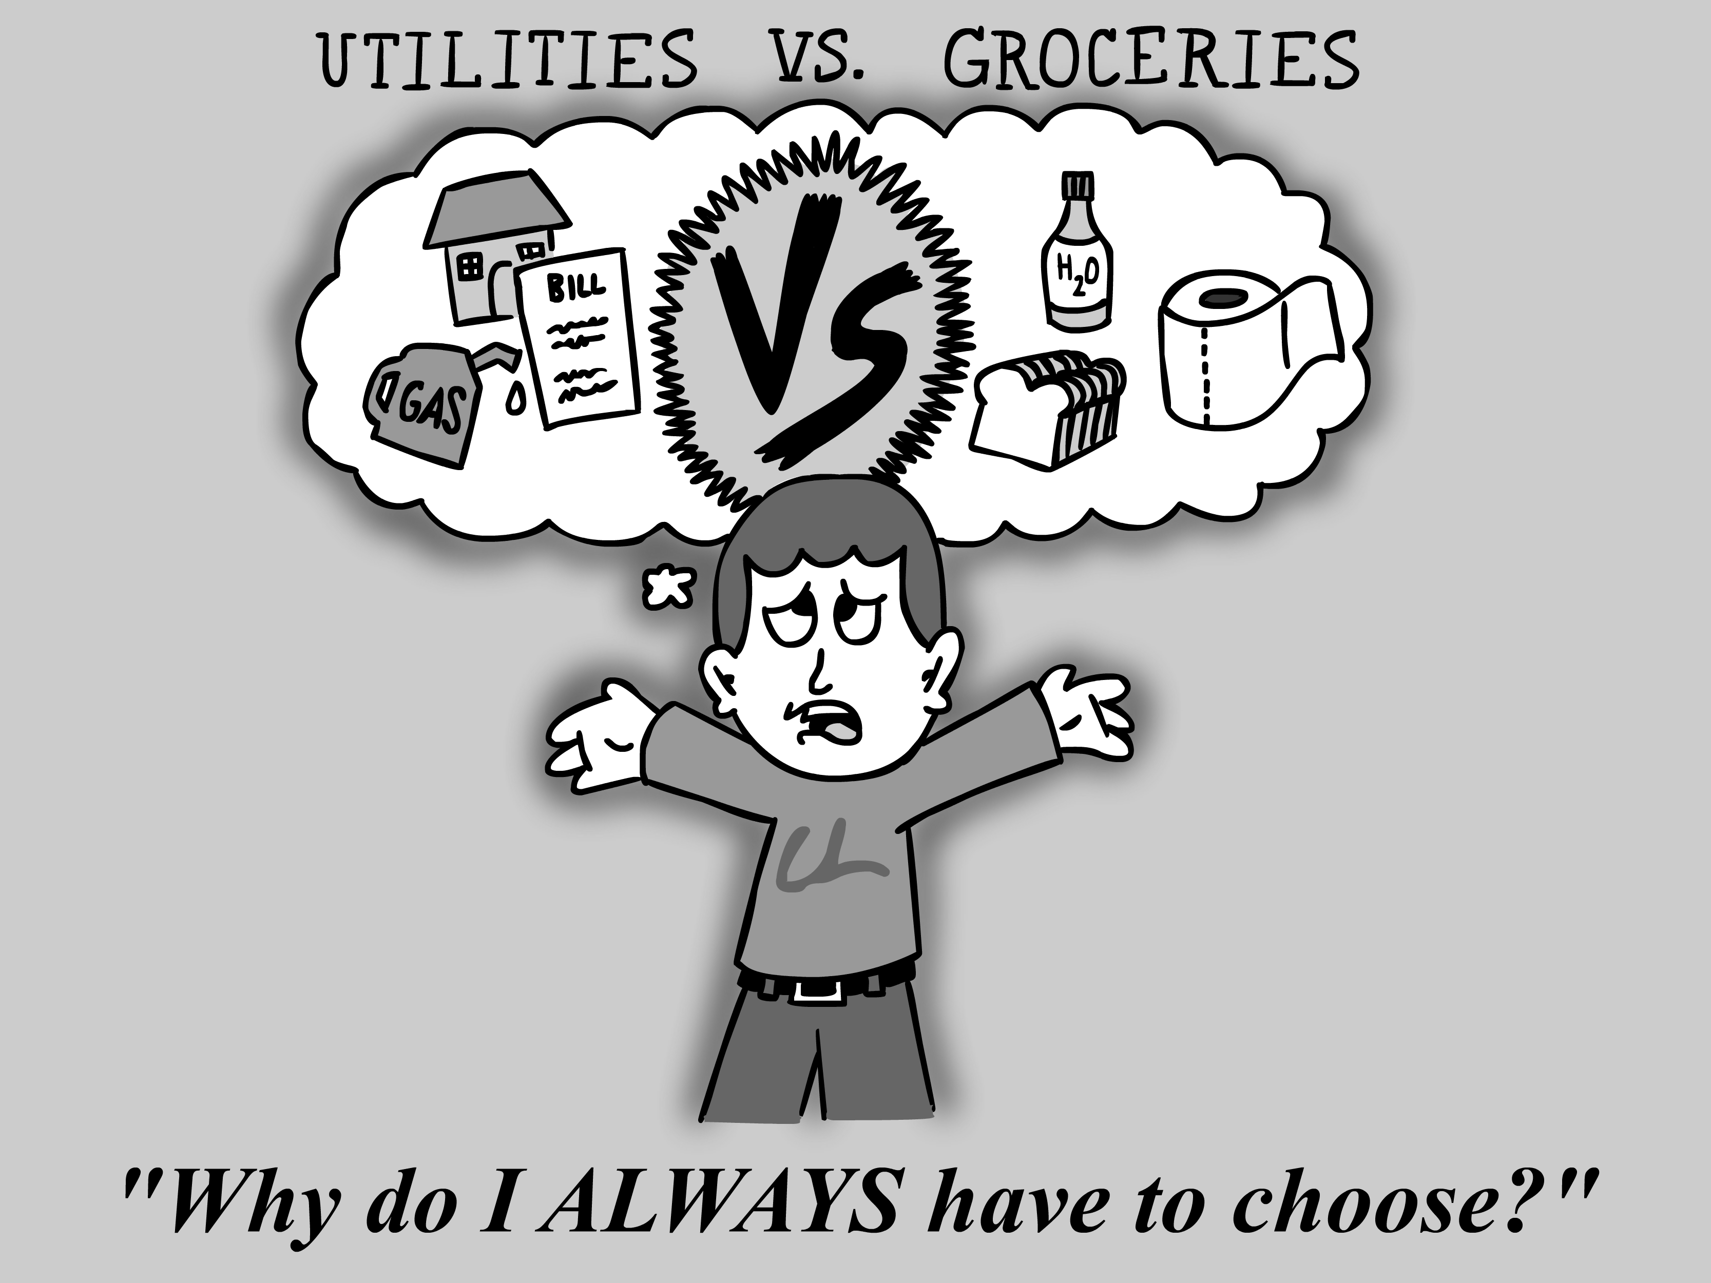
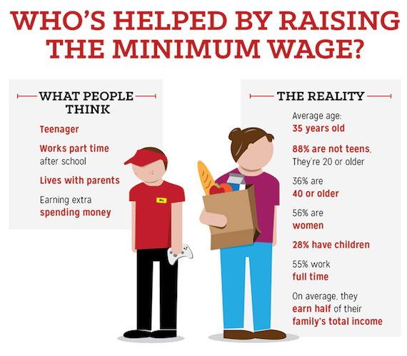
We fight for a worker’s program:
A LIVABLE WAGE!

Slide 16
We fight for a worker’s program:
MEDICARE FOR ALL!

Slide 17
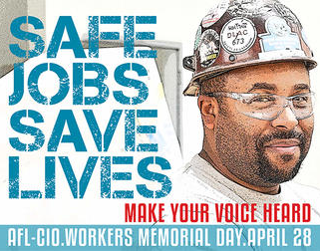
We fight for a worker’s program:
A SAFE WORKPLACE!
Time for OSHA to get real

Slide 18
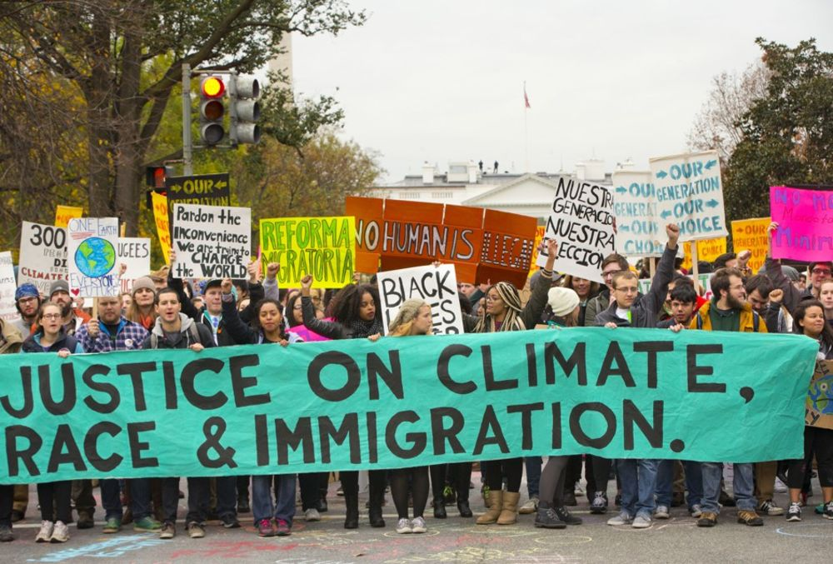
We fight for a worker’s program:
A SAFE ENVIRONMENT!

Slide 19
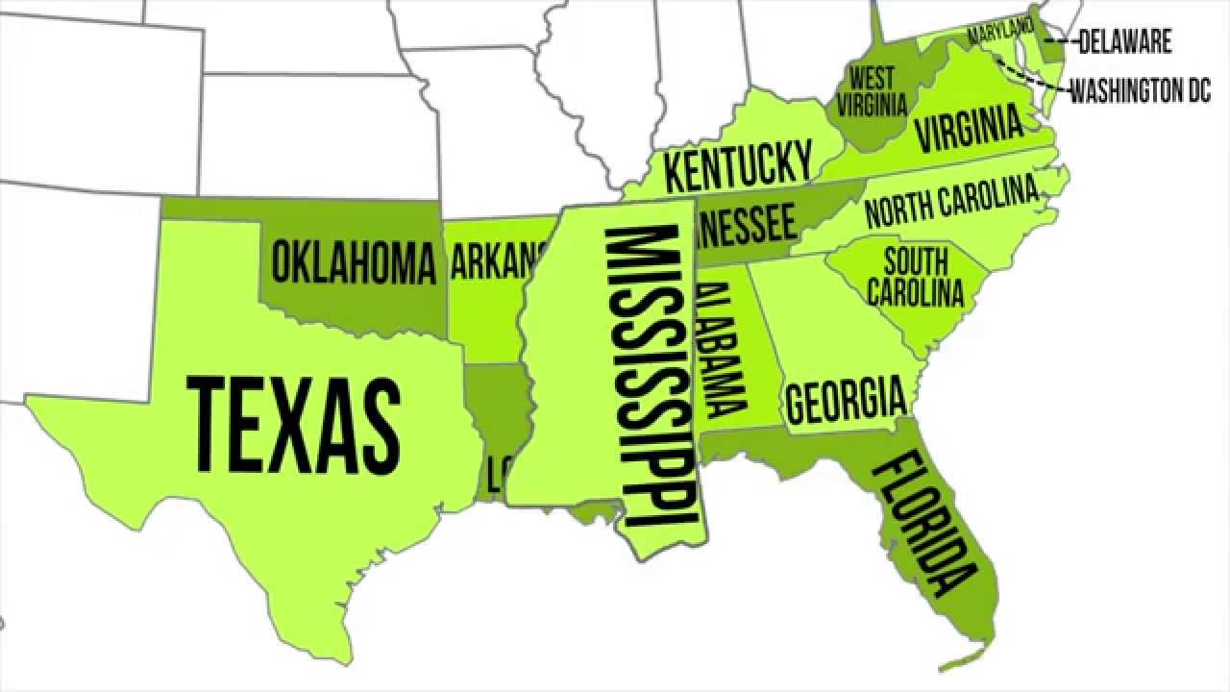
We fight for a worker’s program:
WHAT DEMANDS DO YOU HAVE?
Has anyone ever asked workers in the South?
That’s why we have the Southern Workers Assembly

Slide 20
The future is possible
Questions? Comments?

